Slide 1


Development for Sentiment Analysis Website
PRESENTED BY:
S.Harrshavardhann 221701018
K.I.Ganesh 221701015

Slide 2
INTRODUCTION
Backend manages data, logic, and APIs.
Flask is a lightweight Python web framework.
MySQL stores and manages reviews & colleges.
API enables frontend-backend communication.
Introduction

Slide 3
Tech Stack Used
Frontend:HTML,CSS,Javascript
Backend: Python
Database: MySQL
API: Flask-Python

Slide 4
Database Setup (MySQL)
Tables: Colleges, Reviews
Relationships: College ID in Reviews references Colleges
SQL Queries: CREATE, INSERT, SELECT
Data Storage for sentiment analysis.

Slide 5

Database Design (MySQL)
CREATE TABLE colleges (
id INT AUTO_INCREMENT PRIMARY KEY,
name VARCHAR(255) NOT NULL,
location VARCHAR(255) NOT NULL
);
CREATE TABLE reviews (
id INT AUTO_INCREMENT PRIMARY KEY,
college_id INT,
review_text TEXT NOT NULL,
sentiment_score FLOAT,
created_at TIMESTAMP DEFAULT CURRENT_TIMESTAMP,
FOREIGN KEY (college_id) REFERENCES colleges(id) ON ELETE CASCADE
);
);

Slide 6
Flash API Development
Flask handles HTTP requests (GET, POST)
Endpoints:
- /submit_review (POST): Store user reviews
- /get_reviews (GET): Fetch stored reviews
JSON format used for communication.

Slide 7
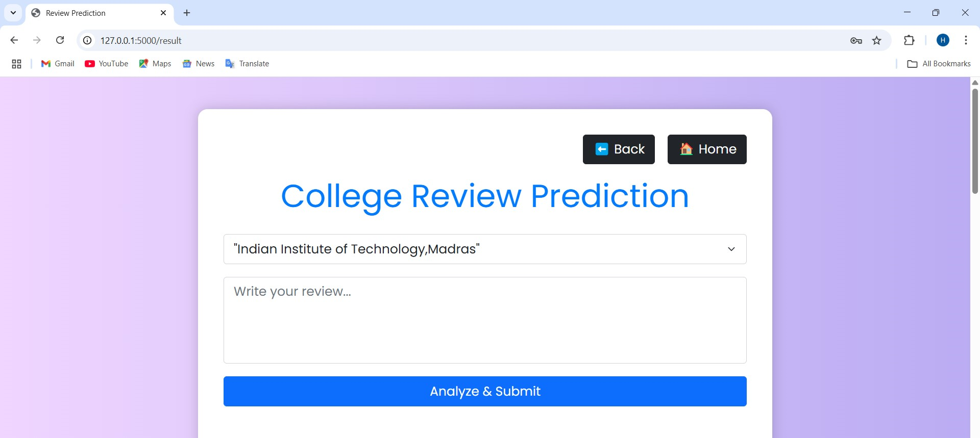
Sample Output

